Slide 1
Employee Data Analysis using Excel
STUDENT NAME: DHARANI B
REGISTER NO: 312216159
DEPARTMENT: BCOM(BANK MANAGEMENT)
COLLEGE: SHRI SHANKARLAL SUNDARBAI SHASUN JAIN COLLEGE FOR WOMENS

Slide 2
PROJECT TITLE
Employee Performance Analysis using Excel

Slide 3


AGENDA
Problem Statement
Project Overview
End Users
Our Solution and Proposition
Dataset Description
Modelling Approach
Results and Discussion
Conclusion
3/21/2024 Annual Review

Slide 4

PROBLEM STATEMENT
This project aims to analyze employee performance data to identify trends and patterns that affect performance ratings and compensation. By examining performance scores, departmental distributions, and any correlations with salary, we seek to uncover insights into performance management and equity. The goal is to enhance performance evaluation processes and ensure fair and effective reward systems.

Slide 5

PROJECT OVERVIEW
This project, titled "Employee Performance Analysis Using Excel," focuses on evaluating employee performance data to uncover trends and disparities in performance ratings. We will analyze performance scores across different departments and assess their correlation with compensation levels. The analysis aims to identify patterns, address potential biases, and improve performance management practices.
.

Slide 6
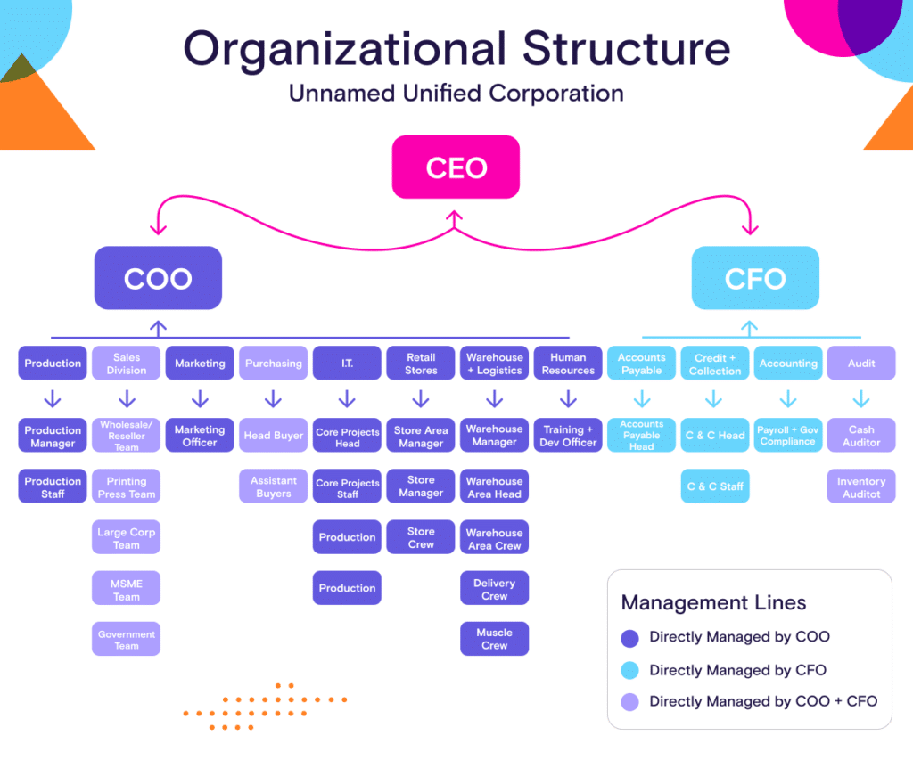
WHO ARE THE END USERS?
HR Managers: Oversee the performance review process, analyze data trends, and generate reports for senior management.
Department Heads: Track and assess the performance of teams or departments, make decisions on promotions, and identify training needs.
Team Leaders: Monitor the performance of their team members, provide feedback, and manage day-to-day performance issues.
Senior Executives: Review overall organizational performance data to make strategic decisions and align performance with company goals.

Slide 7
Recruitment Specialists: Use performance data to identify high-performing employees for internal promotions or to guide recruitment strategies.
Training and Development Coordinators: Analyze performance metrics to tailor training programs and professional development opportunities.
Project Managers: Evaluate team performance on specific projects, assess contributions, and make decisions on project staffing and resource allocation.
Finance Analysts: Use performance data to assess the impact of employee performance on financial outcomes and ROI.
Employee Relations Specialists: Address performance-related employee issues and use data to support conflict resolution and performance improvement plans.
Compliance Officers: Ensure performance evaluation processes and data management adhere to organizational policies and regulatory requirements.

Slide 8

OUR SOLUTION AND ITS VALUE PROPOSITION
Conditional Formatting: Highlights performance trends and anomalies with color-coded cells, making it easier to identify top performers and areas needing improvement.
Filter by color: If using conditional formatting, you can filter based on the colors applied to cells.
Formula :Formulas can help you efficiently analyze employee performance data, track metrics, and generate meaningful insights.
Pivot Table :A pivot table in excel is a powerful tool that allows you to summarize, analyze, and visualize large datasets by reorganizing and aggregating data based on selected criteria.
Graph: Graphs such as bar charts, line charts, and pie charts are used to visually represent data, making it easier to identify trends, patterns, and comparisons. It helps to visualize the data.

Slide 9
Dataset Description
Employee Data Set - KAGGLE
Features -26 Features
Employee Performance Analysis -9 Features :
Employee Id - Numeric
First Name And Last Name -Text
Business Unit - WBL ,CCDR,.., etc
Employee Status - Active, Future Start
Employee Type - Full Time, Part Time , Contract
Employee Classification Type - Full Time , Temporary , Part Time
Gender Code - Female , Male
Performance Score -Exceeds , Fully meet, Needs Improvement
Current Employee Rating - (5,4,3,2,1 )

Slide 10

THE "WOW" IN OUR SOLUTION
Performance Level: Analyzing performance data in Excel using array formula and dynamic range name methods. The recording and analysis of performance data is the quintessential spreadsheet application.
FORMULA: =IFS(Z8>=5,”VERY HIGH”,Z8>=4,”HIGH”,Z8>=3,”MED”,TRUE, “LOW”)
3/21/2024 Annual Review
10

Slide 11
MODELLING
Data Collection:
We compile employee data from various sources, such as HR systems, performance reviews, attendance records, and training logs. This data is centralized in Excel to ensure easy access and consistency.
Data Organization:
Data is organized into structured Excel sheets and tables, categorizing information into different sections like personal details, performance metrics, attendance records, and training history. This ensures data is well-organized and easily navigable.
Data Validation:
We implement data validation rules to maintain data accuracy, ensuring entries are consistent and free from errors. This includes restricting inputs to predefined options (e.g., department names) and validating numerical entries (e.g., scores within a certain range).
Data Cleaning:
Automated processes remove duplicates, fill in missing values, and standardize data formats (e.g., dates), ensuring that the data used for analysis is reliable and accurate.
Performance Metrics Calculation:
KPIs: Define and calculate Key Performance Indicators (KPIs) such as average performance scores, percent completion of goals, and attendance rates using formulas.
Custom Metrics: Develop custom metrics that align with your organization’s performance evaluation criteria.
11

Slide 12
Data Modeling
Pivot Tables: Use Pivot Tables to summarize and analyze performance data by various dimensions such as departments, roles, or time periods.
Formulas: Apply Excel formulas to calculate aggregate metrics, trends, and comparisons (Eg.., IFS).
Visualization
Charts and Graphs: Create visual representations of performance data, such as bar charts for individual comparisons, line graphs for performance trends over time, and pie charts for distribution of performance levels.
Dashboards: Develop interactive dashboards using charts, graphs, and conditional formatting to provide a comprehensive overview of performance metrics.
Scenario Analysis
What-If Analysis: Utilize Excel’s data analysis tools (e.g., Scenario Manager, Data Tables) to explore different performance scenarios and their potential impact.
Trend Analysis: Analyze historical performance data to identify trends and predict future performance outcomes.
Reporting
Automated Reports: Create automated report templates to summarize performance findings, highlight key metrics, and generate periodic performance summaries.
Custom Reports: Develop tailored reports for specific stakeholders, such as detailed departmental performance reviews or executive summaries.

Slide 13
RESULTS
Employee performance analysis using Excel has enabled precise tracking of individual and team performance, identifying high performers and those needing improvement. This data-driven approach has led to tailored training, increased productivity, enhanced decision-making, and improved overall employee satisfaction and retention.
13

Slide 14
CONCLUSION
Using Excel for employee performance analysis has proven highly effective for our organization. Excel’s tools have enabled us to gather, organize, and analyze performance data efficiently, providing clear insights into employee strengths and areas needing improvement. This approach has improved productivity, supported targeted training programs, reduced turnover, and enhanced decision-making by offering real-time performance visibility. Overall, Excel has been a valuable tool in fostering a data-driven culture, optimizing employee performance, and aligning our workforce with strategic business goals.

